Slide 1
A MACHINE LEARNING APPROACH USING STATISTICAL MODELS FOR EARLY DETECTION OF CARDIAC ARREST IN NEWBORN BABIES IN THE CARDIAC INTENSIVE CARE UNIT

Slide 2
ABSTRACT
Cardiac arrest in newborn babies is an alarming yet typical medical emergency. Early detection is critical for providing these babies with the best care and treatment. Recent research has focused on identifying the potential indicators and biomarkers of cardiac arrest in newborn babies and developing accurate and efficient diagnostic tools for early detection. An array of imaging techniques, such as echocardiography and computed tomography may help provide early detection of cardiac arrest. This research aims to develop a Cardiac Machine Learning model (CMLM) using statistical models for the early detection of cardiac arrest in newborn babies in the Cardiac Intensive Care Unit (CICU). The cardiac arrest events were identified using a combination of the neonate’s physiological parameters. Statistical modeling techniques, such as logistic regression and support vector machines, were used to construct predictive models for cardiac arrest. The proposed model will be used in the CICU to enable early detection of cardiac arrest in newborn babies. In a training (Tr) comparison region, the proposed CMLA reached 0.912 delta-p value, 0.894 False discovery rate (FDR) value, 0.076 False omission rate (FOR) value, 0.859 prevalence threshold value and 0.842 CSI value. In a testing (Ts) comparison region, the proposed CMLA reached 0.896 delta-p values, 0.878 FDR value, 0.061 FOR value, 0.844 prevalence threshold values and 0.827 CSI value. It will help reduce the mortality and morbidity of newborn babies due to cardiac arrest in the CICU.

Slide 3
INTRODUCTION
Cardiac arrest in newborn babies is a devastating event that can lead to severe complications and death. Early detection of this condition is critical to provide the best care for these infants and ensure their long-term health. In order to ensure the early detection of cardiac arrest in newborn babies, it is essential to understand the signs and symptoms associated with this condition and the risk factors that may put a baby at an increased risk of cardiac arrest [1]. The most common signs and symptoms of cardiac arrest in newborn babies are a rapid heart rate and difficulty breathing. Other signs that may indicate a baby is in cardiac arrest include a bluish tinge to the baby’s skin, unresponsiveness, or decreased movement. If any of these signs are present, it is essential to seek medical attention immediately. Risk factors that may increase the likelihood of cardiac arrest in newborn babies include low birth weight, a family history of cardiac arrest, preterm birth, a difficult delivery, or a mother with a history of high blood pressure during pregnancy [2]. A baby’s medical history should also be evaluated for any potential risks. In order to ensure early detection of cardiac arrest in newborn babies, regular monitoring of the baby’s heart rate and respiratory rate is essential. It can be done through pulse oximetry, a noninvasive, painless procedure that measures the amount of oxygen in the baby’s blood [3].

Slide 4
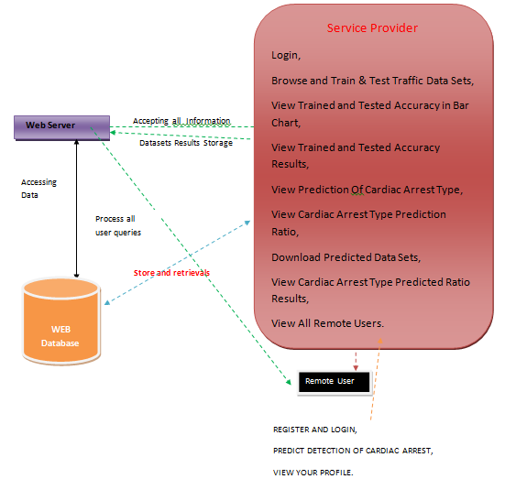
Architecture

Slide 5
EXISTING SYSTEM
Carlisle et al. [21] has discussed the Heart failure is when the heart cannot pump enough blood to the rest of the body. Various conditions, including high blood pressure, coronary artery disease, and diabetes, can cause it. Atrial fibrillation is an arrhythmia (irregular heartbeat) in which the heart’s upper chambers (atria) beat rapidly and irregularly. It can cause a decrease in the amount of blood pumped to the rest of the body, leading to symptoms such as shortness of breath and fatigue. Atrial fibrillation is a common cause of heart failure. Heart failure and atrial fibrillation treatment usually involve medications to control the heart rate and rhythm, lifestyle changes, and sometimes surgery to repair or replace the heart.

Slide 6
Disadvantages existing system
• The complexity of data: Most of the existing machine learning models must be able to accurately interpret large and complex datasets to detect cardiac arrest in newborn babies.
• Data availability: Most machine learning models require large amounts of data to create accurate predictions. If data is unavailable in sufficient quantities, then model accuracy may suffer.
• Incorrect labeling: The existing machine learning models are only as accurate as the data trained using the input dataset. If the data has been incorrectly labeled, the model cannot make accurate predictions.

Slide 7
PROPOSED SYSTEM
In the existing system,ml models can be used to identify the most critical risk factors associated with the condition and predict the likelihood of an infant experiencing an arrest. Therefore, these statistical models should be used to improve newborns’ early detection and intervention of cardiac arrest [17].
Machine learning is increasingly used to predict and detect cardiac arrest in newborn babies. Cardiac arrest is a life-threatening condition in which the heart suddenly stops beating, and blood flow to the brain and other organs stops. It can lead to permanent brain damage or death. Due to the complexity of the condition, early detection of cardiac arrest in newborns has been difficult. However, machine learning is changing that [18].

Slide 8
Advantages proposed system
• Automated and accurately detected critical signs associated with cardiac arrest in newborn babies.
• Ability to recognize subtle changes in the baby’s vital signs that can indicate potential cardiac arrest.
• Ability to identify high-risk babies likely to suffer from cardiac arrest.
• Early detection of cardiac arrest, enabling timely interventions that can improve the outcome.
• Reduction in the time and cost associated with traditional monitoring methods.
• Improved patient outcomes due to early diagnosis and treatment of cardiac arrest.

Slide 9
SYSTEM REQUIREMENTS
➢ H/W System Configuration:-
➢ Processor - Pentium –IV
➢ RAM - 4 GB (min)
➢ Hard Disk - 20 GB
➢ Key Board - Standard Windows Keyboard
➢ Mouse - Two or Three Button Mouse
➢ Monitor - SVGA

Slide 10
SOFTWARE REQUIREMENTS:
Operating system : Windows 7 Ultimate.
Coding Language : Python.
Front-End : Python.
Back-End : Django-ORM
Designing : Html, css, javascript.
Data Base : MySQL (WAMP Server).

Slide 11
CONCLUSION
The proposed machine learning-based statistical model is essential for the early detection of cardiac arrest in newborn babies in the Cardiac Intensive Care Unit (CICU) because they enable the efficient and accurate identification of infants at high risk of cardiac arrest. Machine learning models can accurately identify subtle changes in vital signs, such as heart and respiration rates, that may indicate an impending cardiac arrest. In a training (Tr) comparison region, the proposed CMLA reached 0.912 delta-p value, 0.894 FDR value, 0.076 FOR value, 0.859 prevalence threshold value and 0.842 CSI value. In a testing (Ts) comparison region, the proposed CMLA reached 0.896 delta-p values, 0.878 FDR value, 0.061 FOR value, 0.844 prevalence threshold values and 0.827 CSI value. The proposed cardiac machine learning model to identify at-risk infants, healthcare providers can provide early intervention that may help to avert a tragic outcome. Early detection of cardiac arrest can also reduce the amount of time an infant spends in the CICU, helping to reduce costs and improve outcomes.

Slide 12


